Slide 1


Smooth Operator
Move anything, anywhere, anytime
Celine Chen, Eric Chen, Jacob Chin, Nicholas Nguyen, Christian So
Final Presentation PDR
Notes:
Jacob

Slide 2
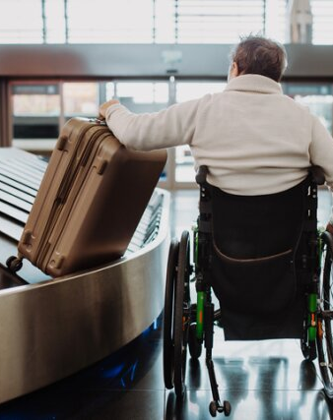
In fast-paced environments requiring hospitality such as airports and hotels, there is a decline in service workers in the U.S. For those with mobility impairments, moving luggage and heavy objects can be a strenuous and daunting task.
Problem Statement
SmoothOperator
Notes:
Jacob

Slide 3
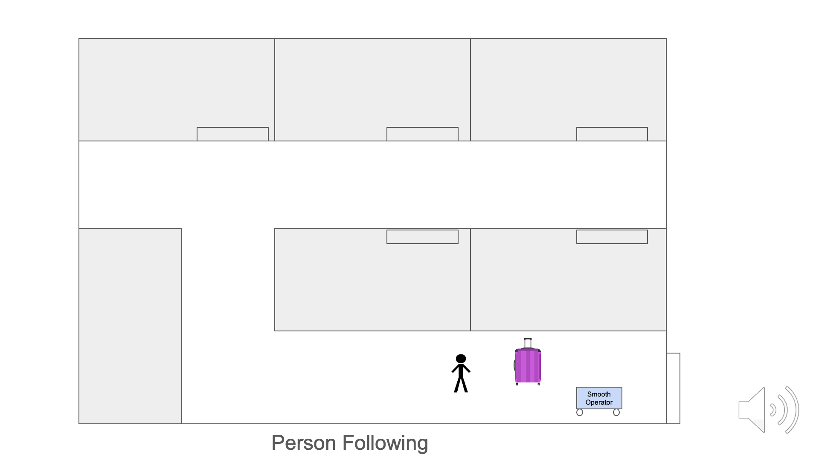
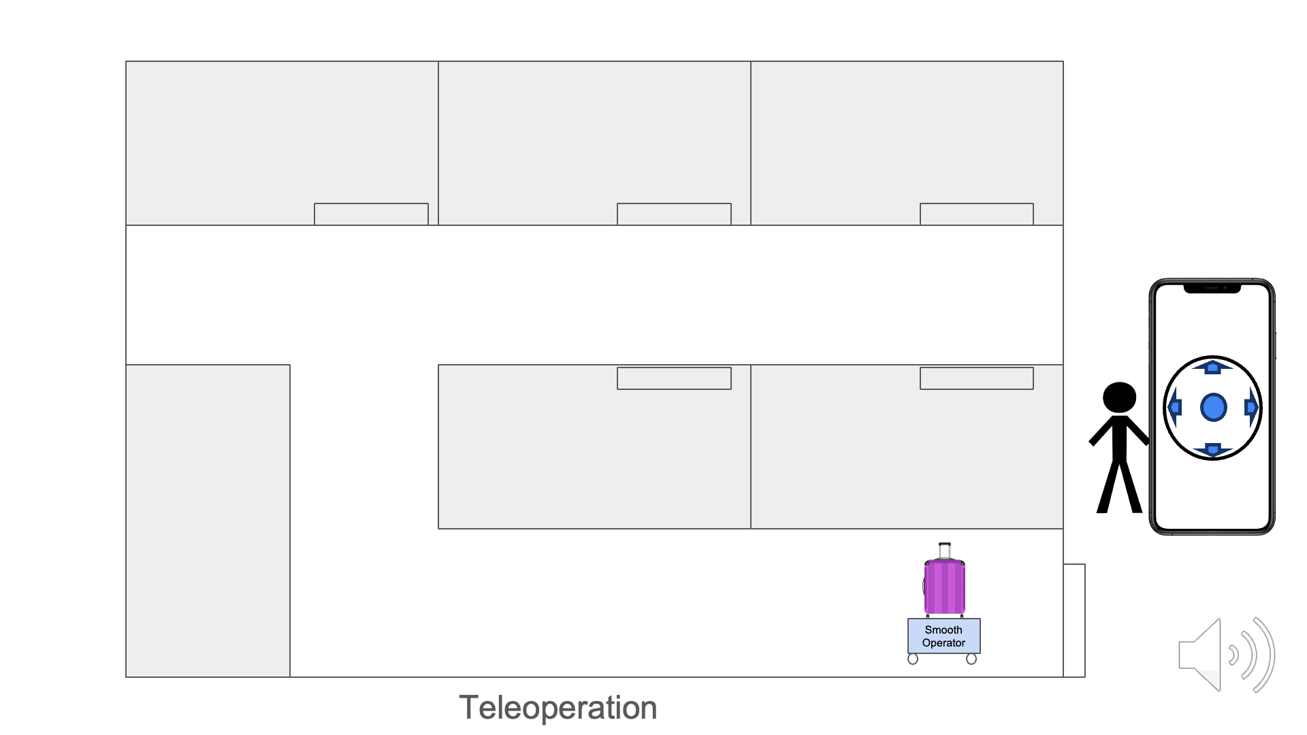
SmoothOperator
Enhance the quality of life by facilitating easy and
safe movement of objects
Our Solution
Roboticized Dolly
Facilitates easy & safe movement of objects
Adaptable to many environments
Semi-autonomous navigation & obstacle avoidance
User-friendly app to connect to robot
SmoothOperator
Notes:
Jacob

Slide 4

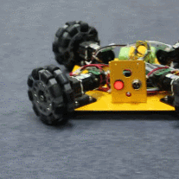

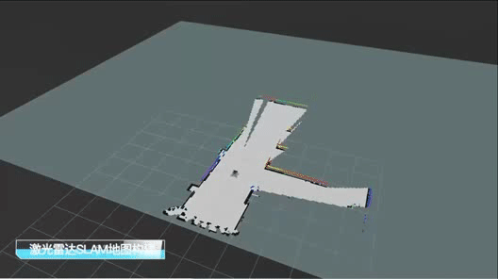
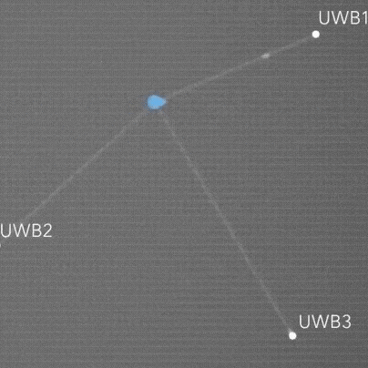
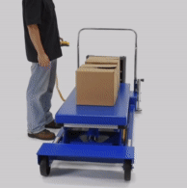
Minimum Viable Product
MVP
Robot
Software
Network
Reach Goals
50 lbs minimum weight capacity
Moves 1.2 m/s
Zero-degree turns for nimble movements
Able to map the environment (SLAM)
User testing with easy-to-use rate of 70%
Sensor filters with percent error of 5%
Latency of under 100 ms
Can send instructions and sensor data to the robot via WiFi
UWB triangulation
1 kHz frequency communication
Follows user via camera
Able to navigate elevators, ramps, etc
Cohort of robots that are controlled by server
Lifting mechanism
SmoothOperator
Notes:
Jacob

Slide 5
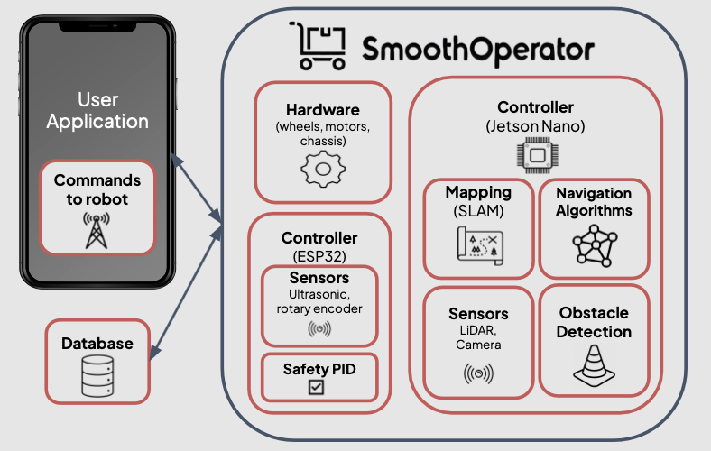
System Design
Notes:
Christian
For our system design, we broke it in several components
Starting off with the user application, this is where the user sends commands to the SmoothOperator. They can send manual commands or location inputs.
Within the smoothoperator itself, it consist of the hardware: wheels motors and the chassis
A microcontroller specifically a ESP32 which consist of sensors like utrasonics and rotary encoders. And a safety PID. the reason why we choose to use another microcontroller and assign it to these specific sensors were so that there’s no bottlenecks in the
The reason why we have two controllers is because safety is our highest priority. Having two controllers decreases latency delays since we have many different sensor data, algorithms, mapping occurring.
Lastly, we will host a database that will store the different maps of the rooms, airports, and hotel. As well as logs from the different components so developers are able to track the different systems and communications running

Slide 6
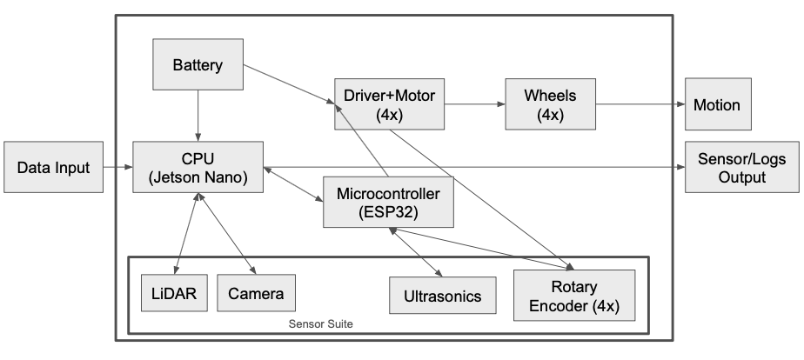
System Block Diagram
Hardware
Notes:
Christian

Slide 7
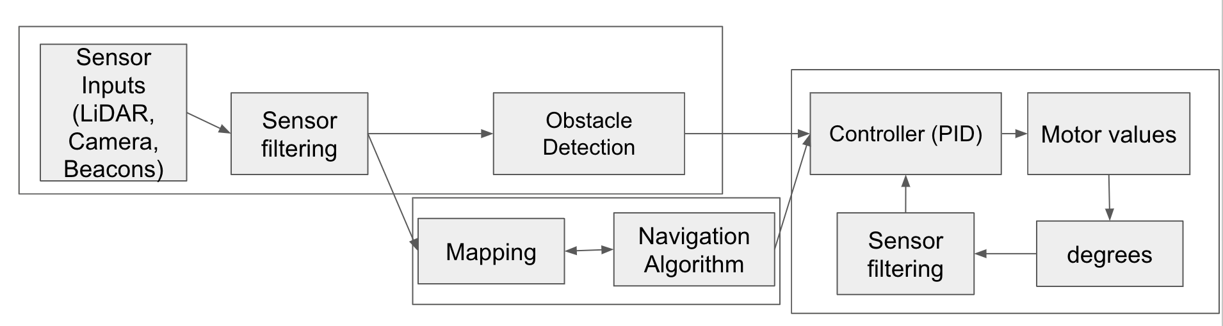
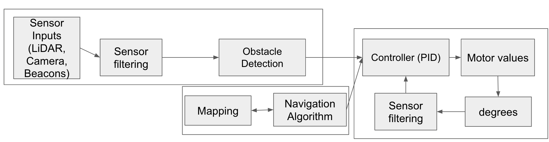
System Design
Initialization Phase
Running Phase
Notes:
Christian

Slide 8
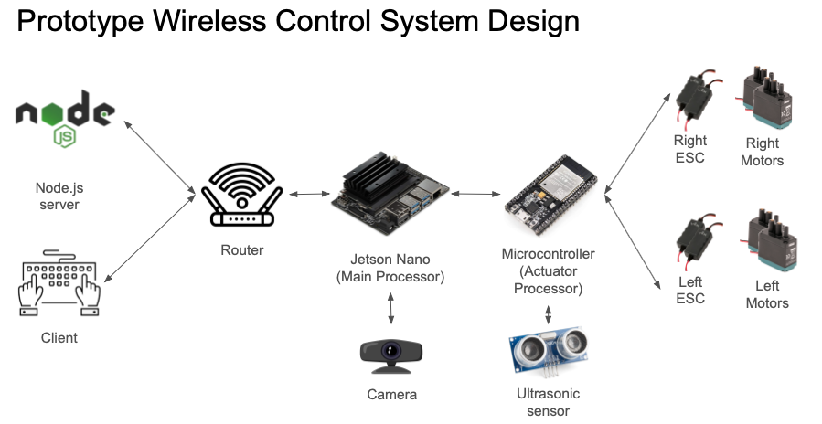
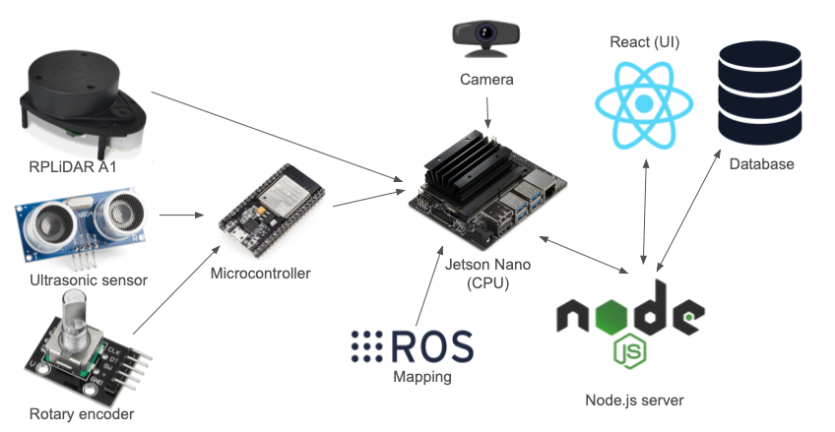
System Design
Prototype
Final
Currently working towards

Slide 9
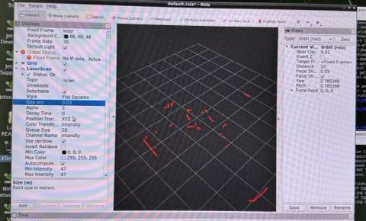
LiDAR (RViz)
Technology/Design
Visualized the sensor data on RViz (visualization tool for ROS) to see LiDAR measurements in a 360 degree radius
We were able to see the red lines on RViz changing as objects moved around
RViz LiDAR data visualization
Smooth Operator
Notes:
Eric

Slide 10
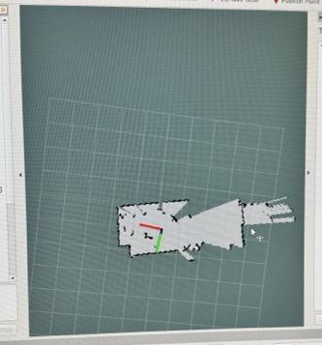
Mapping (Hector SLAM)
Technology/Design
Tested out Hector SLAM, which creates a map of the environment
Slowly moved the LiDAR around the room to get measurements and the map would slowly be built over time
Image shows a mapping of the senior design lab
Red circle shows laser going through glass
Hector SLAM mapping
Smooth Operator
Notes:
Eric

Slide 11
Next Steps
Technology/Design
Mount LiDAR on v0 prototype to assess real-world performance while in motion
Compare stationary and dynamic mapping results and parameter tune until the map is acceptable
Export maps into a usable format for our autonomous navigation stack
Add safety features such as sound and lights
Smooth Operator
Notes:
Eric

Slide 12
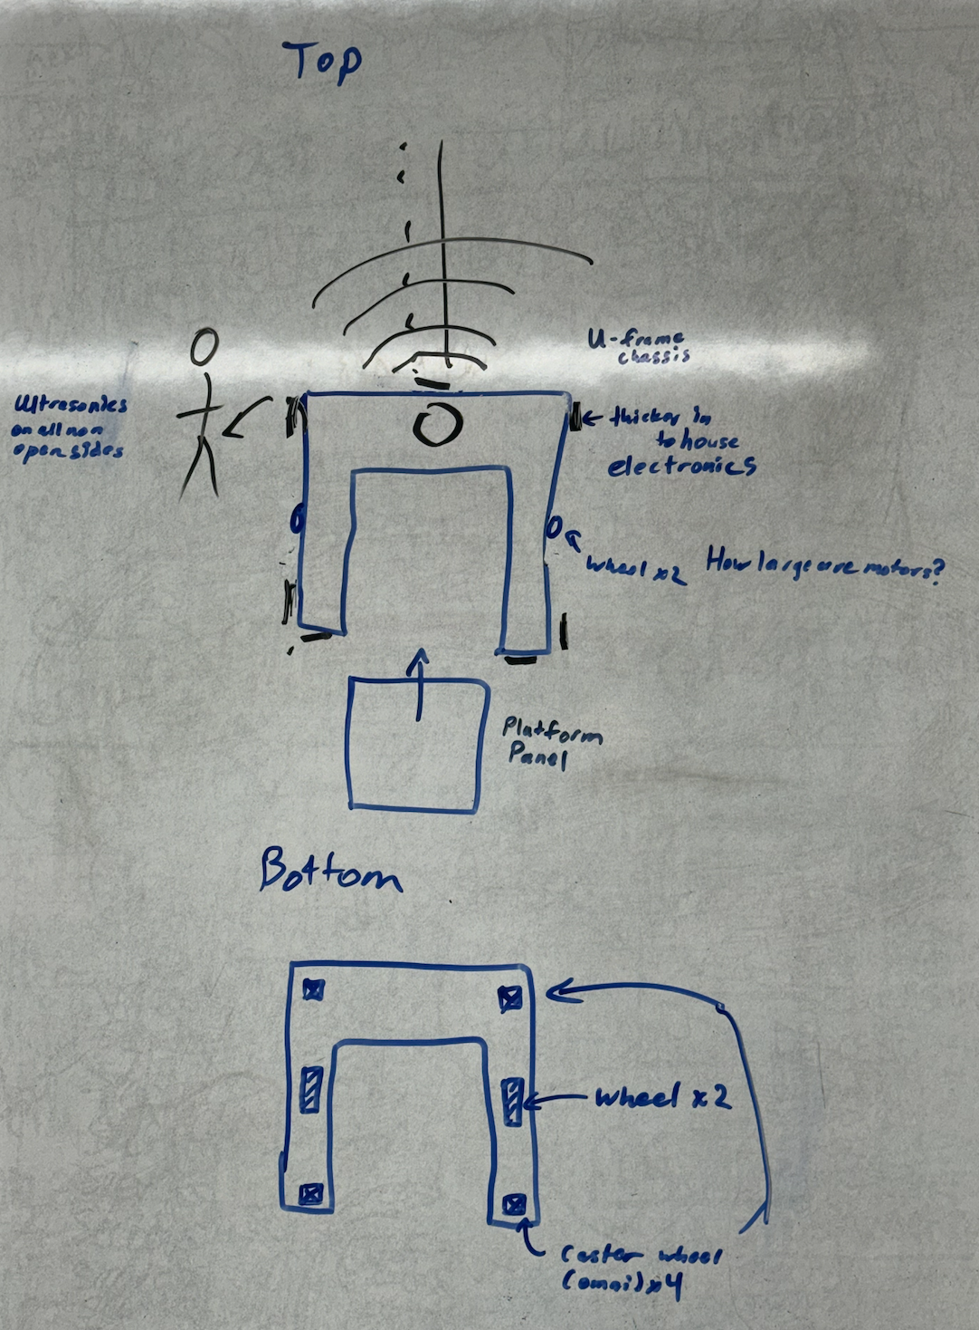
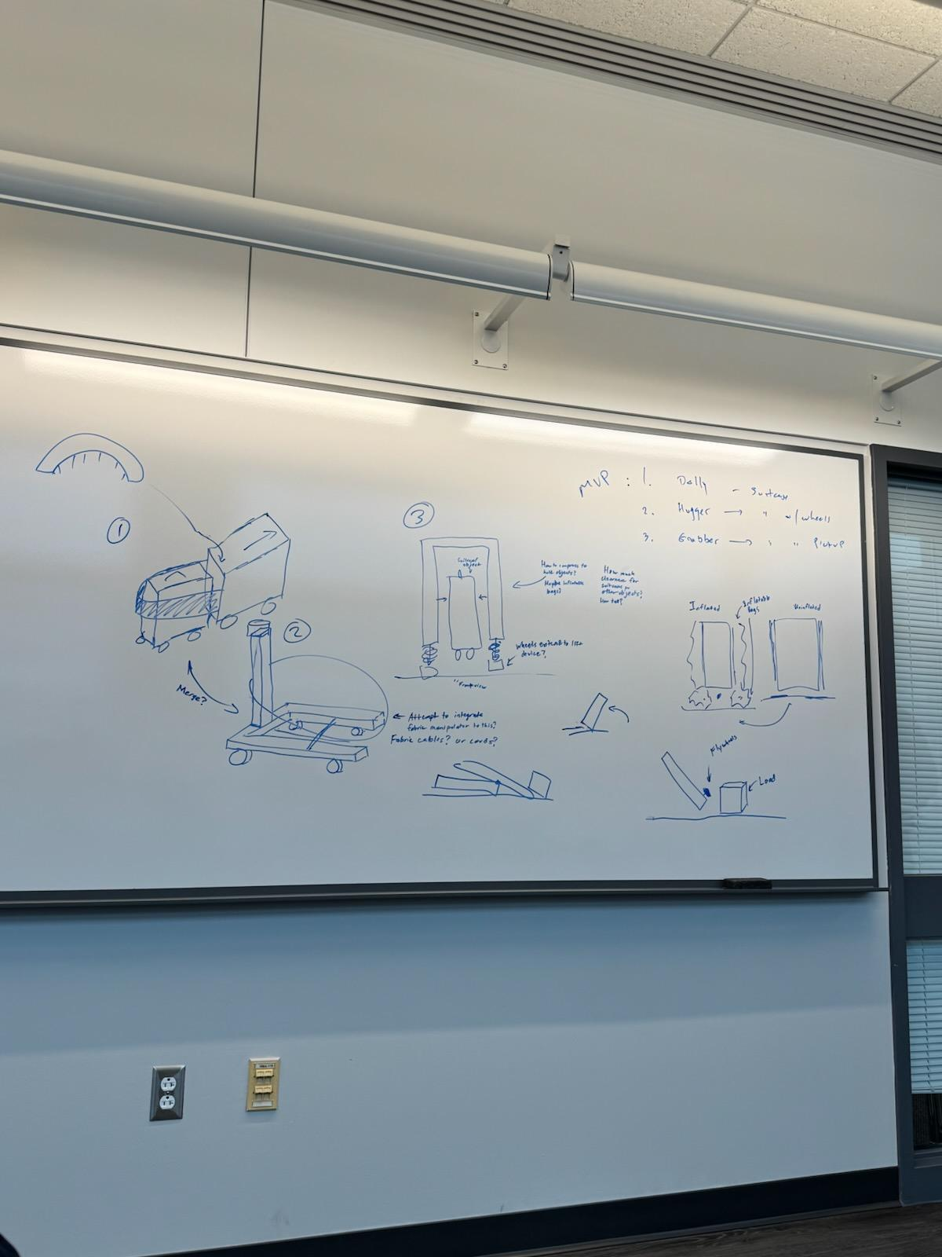
Chassis
Development
Technology/Design
Preliminary Design Sketches
Chassis Sketch
Smooth Operator
Notes:
Nicholas

Slide 13
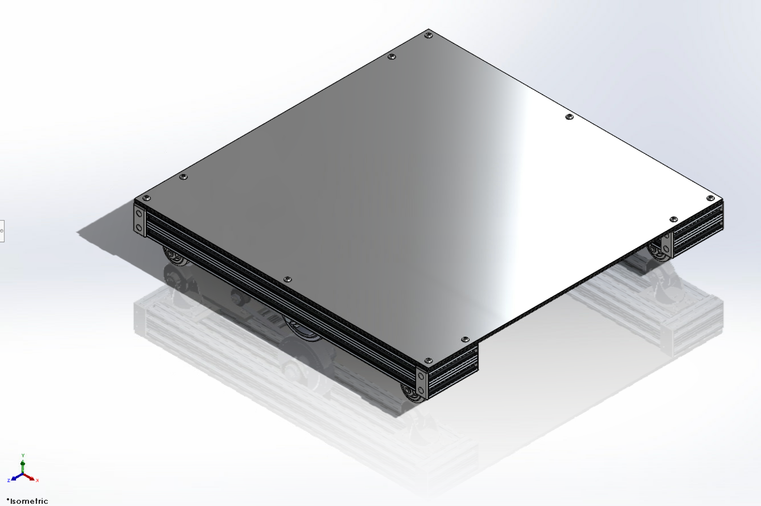
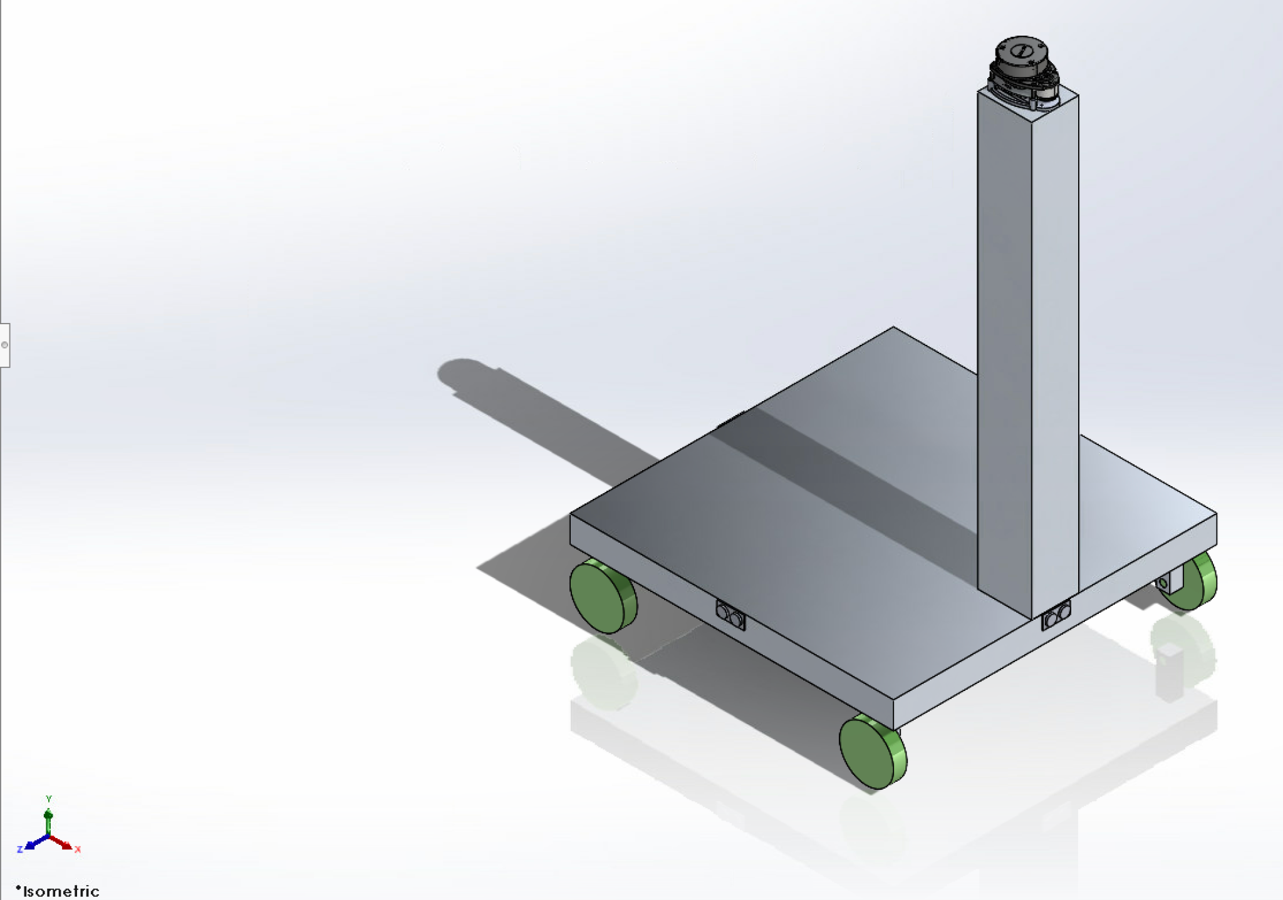
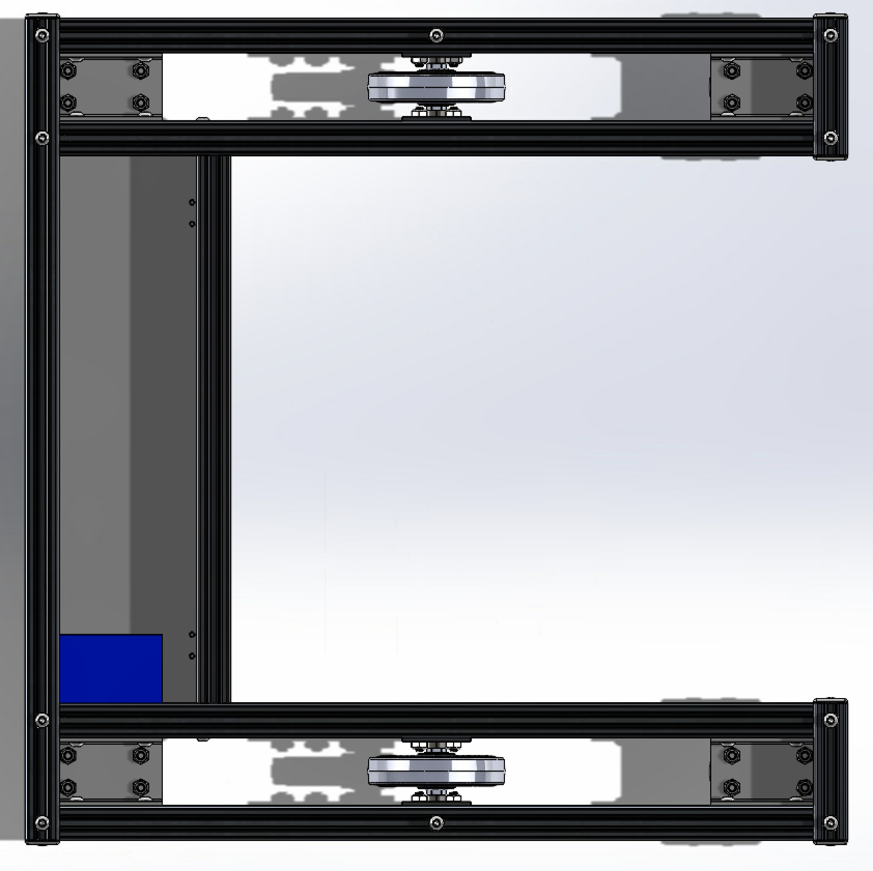
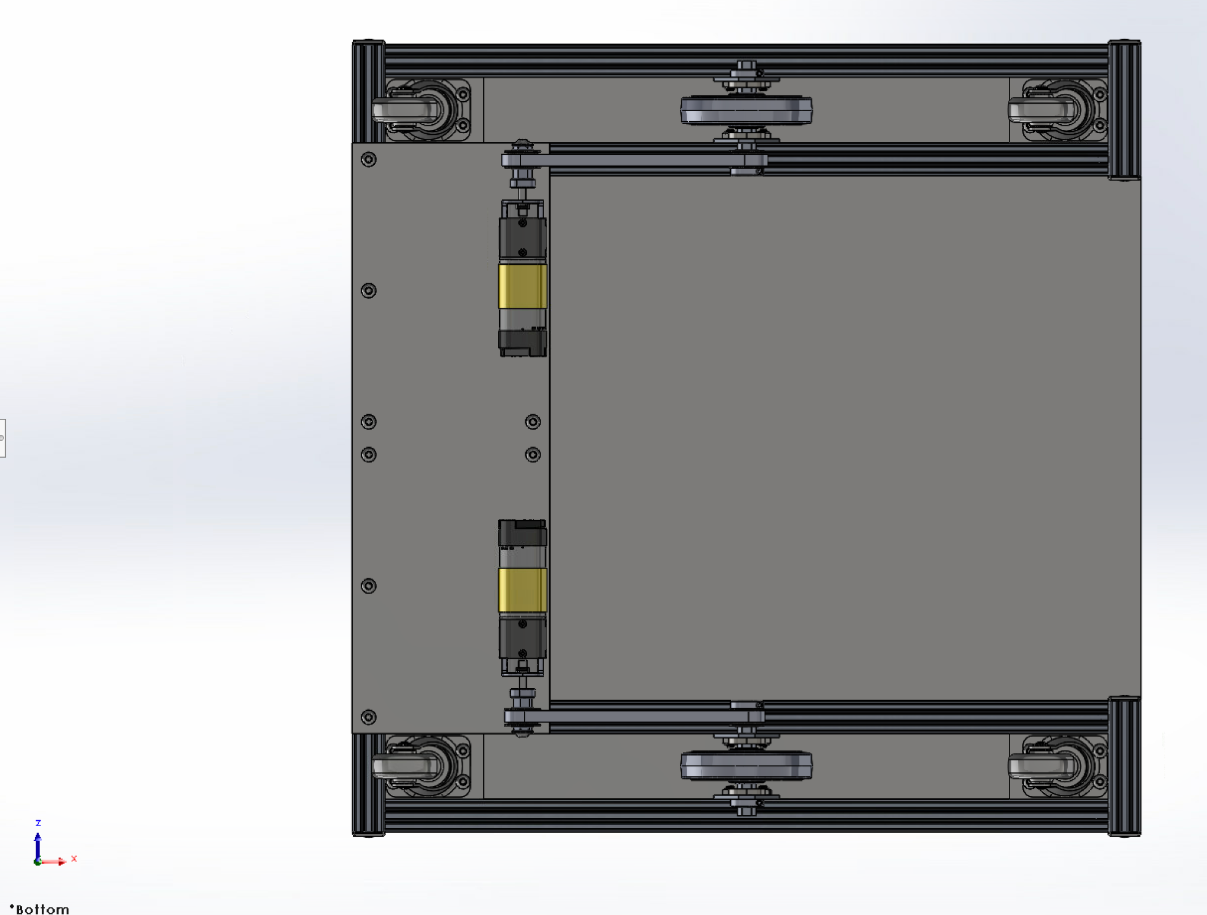
Chassis CAD
Technology/Design
Current Chassis Isometric View
First Chassis Isometric View
Current Chassis Top View
(removed top plate)
Current Chassis Bottom View
Smooth Operator
Notes:
Nicholas

Slide 14
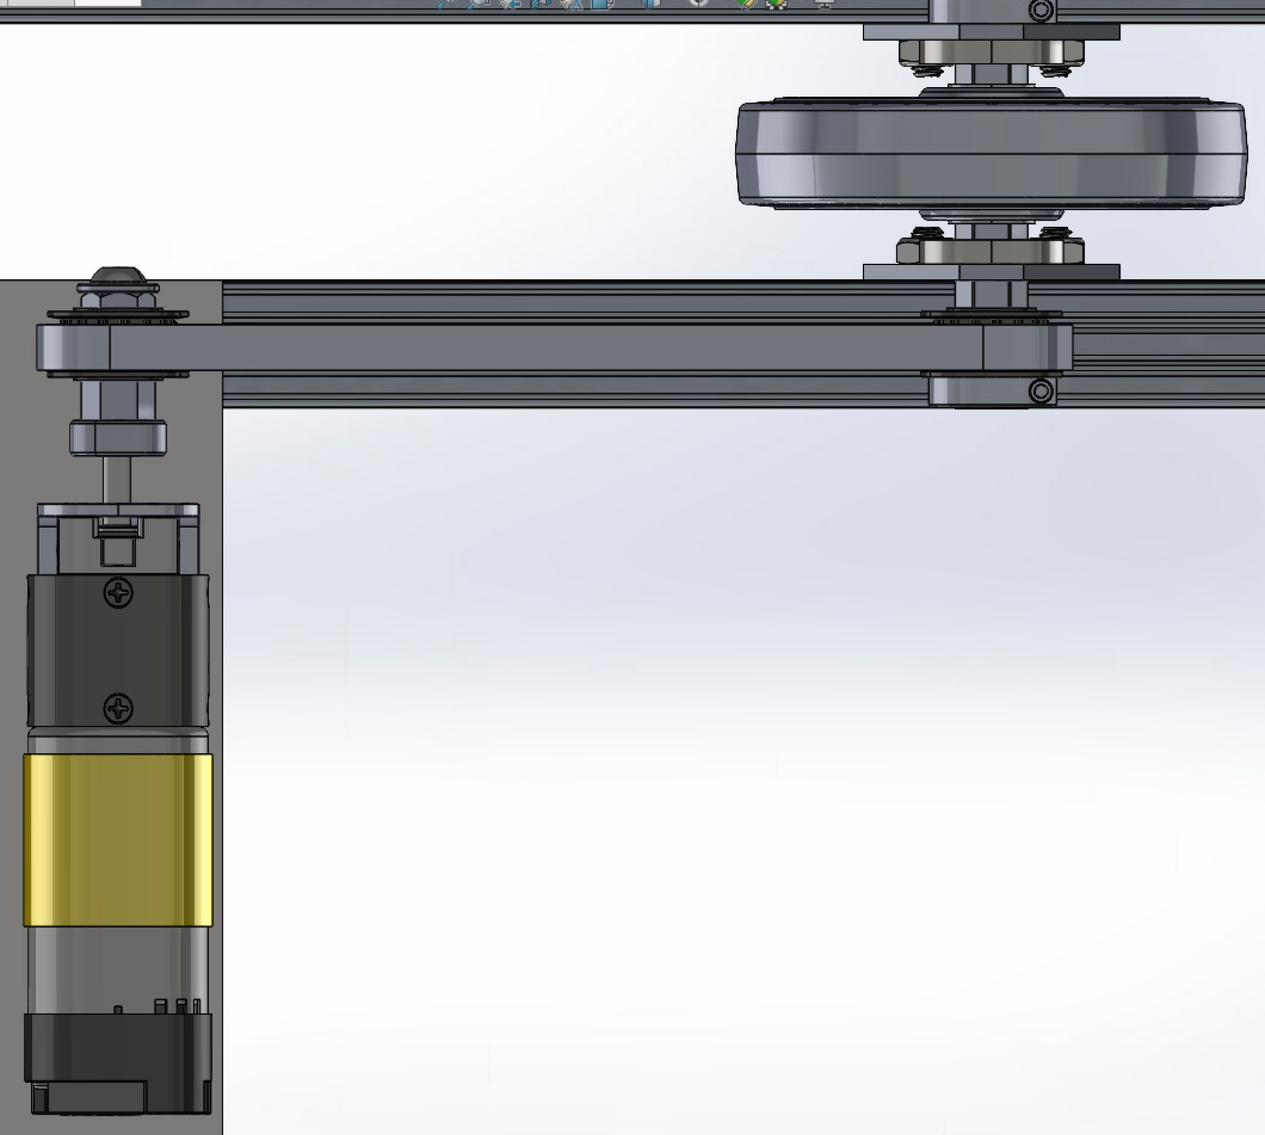
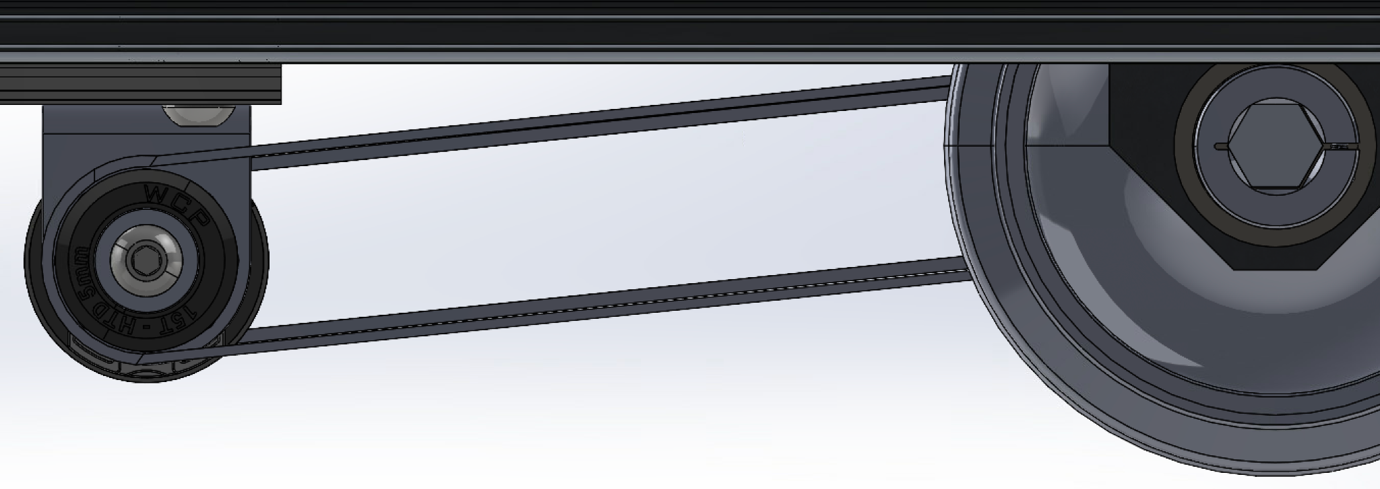
Belt System
Technology/Design
Belt system close-up side view
Belt system close-up top view
Smooth Operator
Notes:
Nicholas

Slide 15
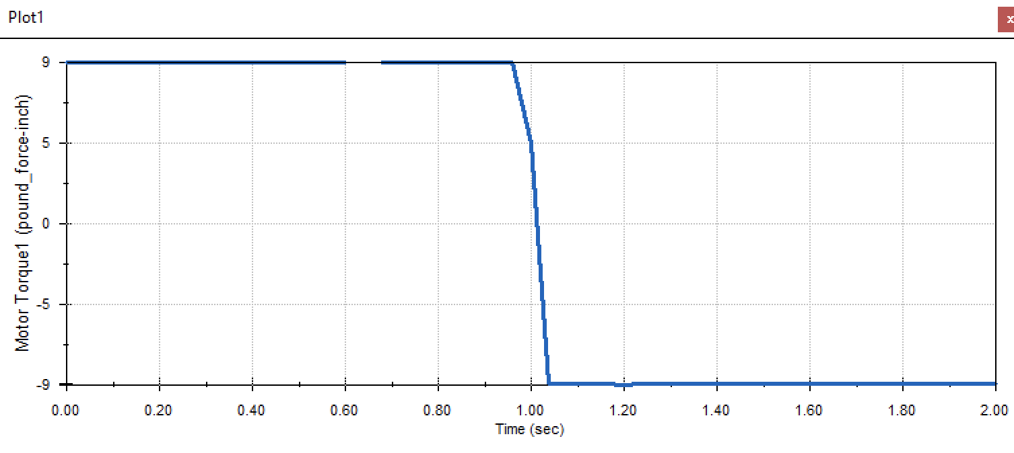
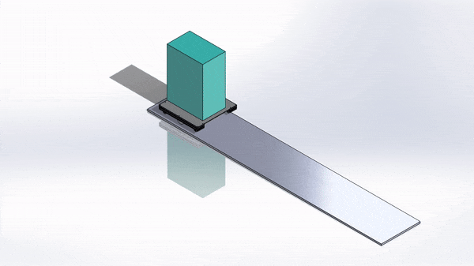
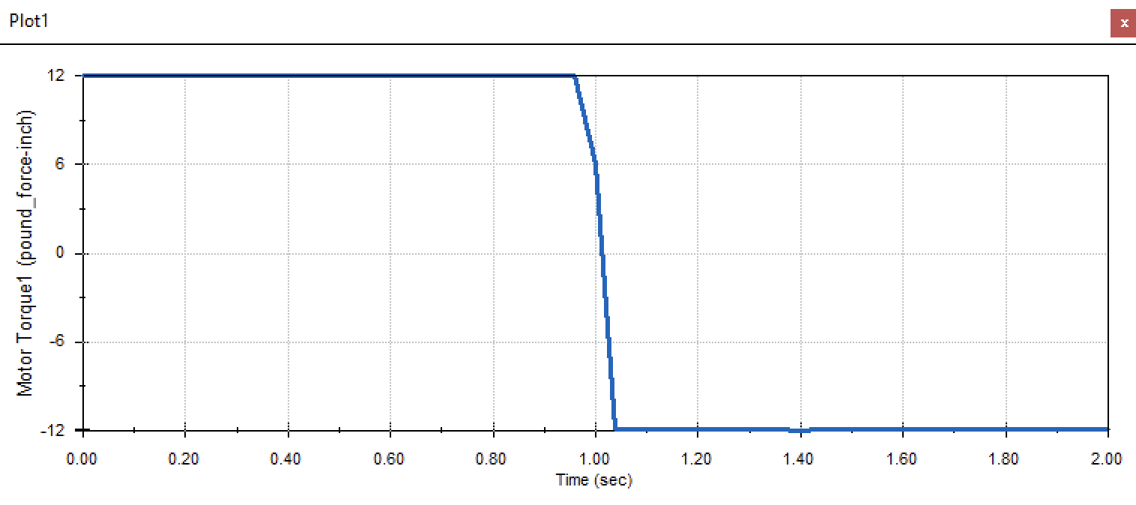
Motor Analysis
Technology/Design
Motor Torque vs. Time Plot for 100 lb Load
Motor Torque vs. Time Plot for 150 lb Load
Smooth Operator
Notes:
Nicholas

Slide 16
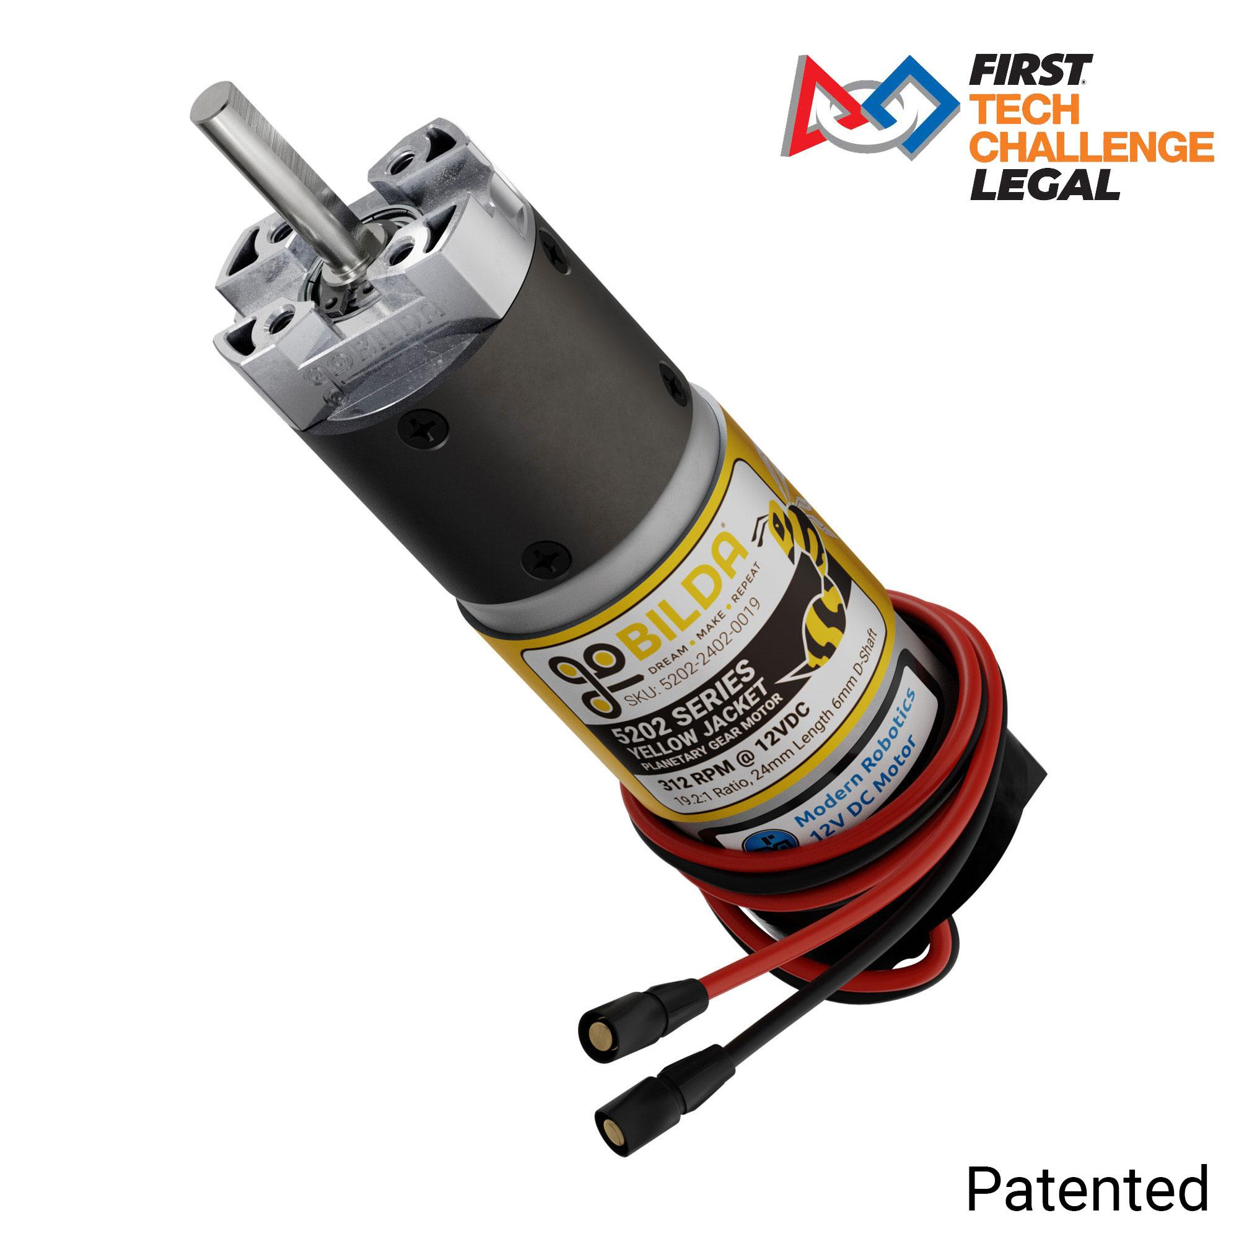
Motor Selection
Technology/Design
Why
Provides more than sufficient torque for applications (338 oz-in stall torque)
12VDC nominal voltage
Sufficient no load speed of 312 RPM at 12VDC
Integrated Encoder
goBILDA has existing hardware compatible with this motor
goBILDA 5202 Series Yellow Jacket Planetary Gear Motor
Smooth Operator
Notes:
Nicholas

Slide 17
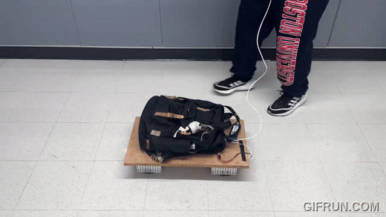
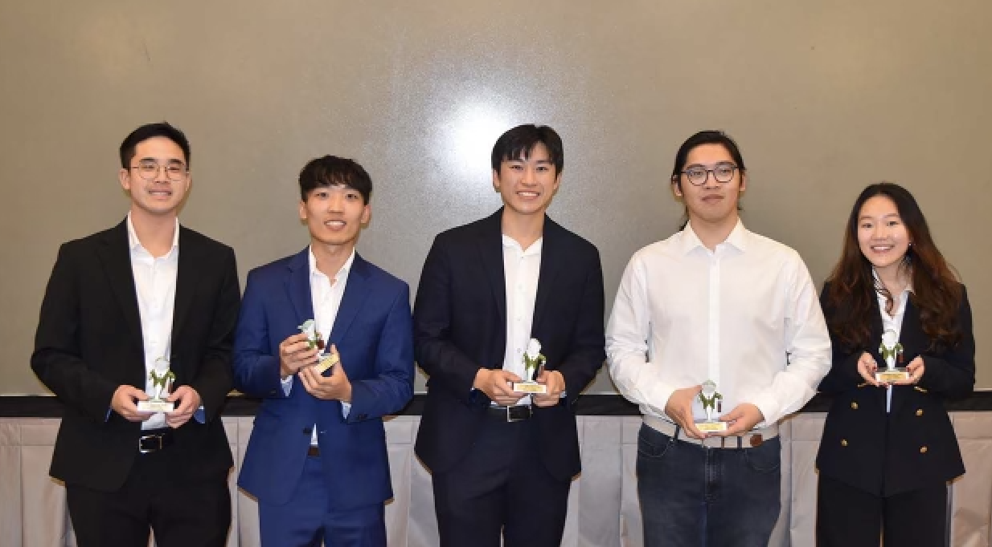
First Semester Prototype
Notes:
Celine

Slide 18
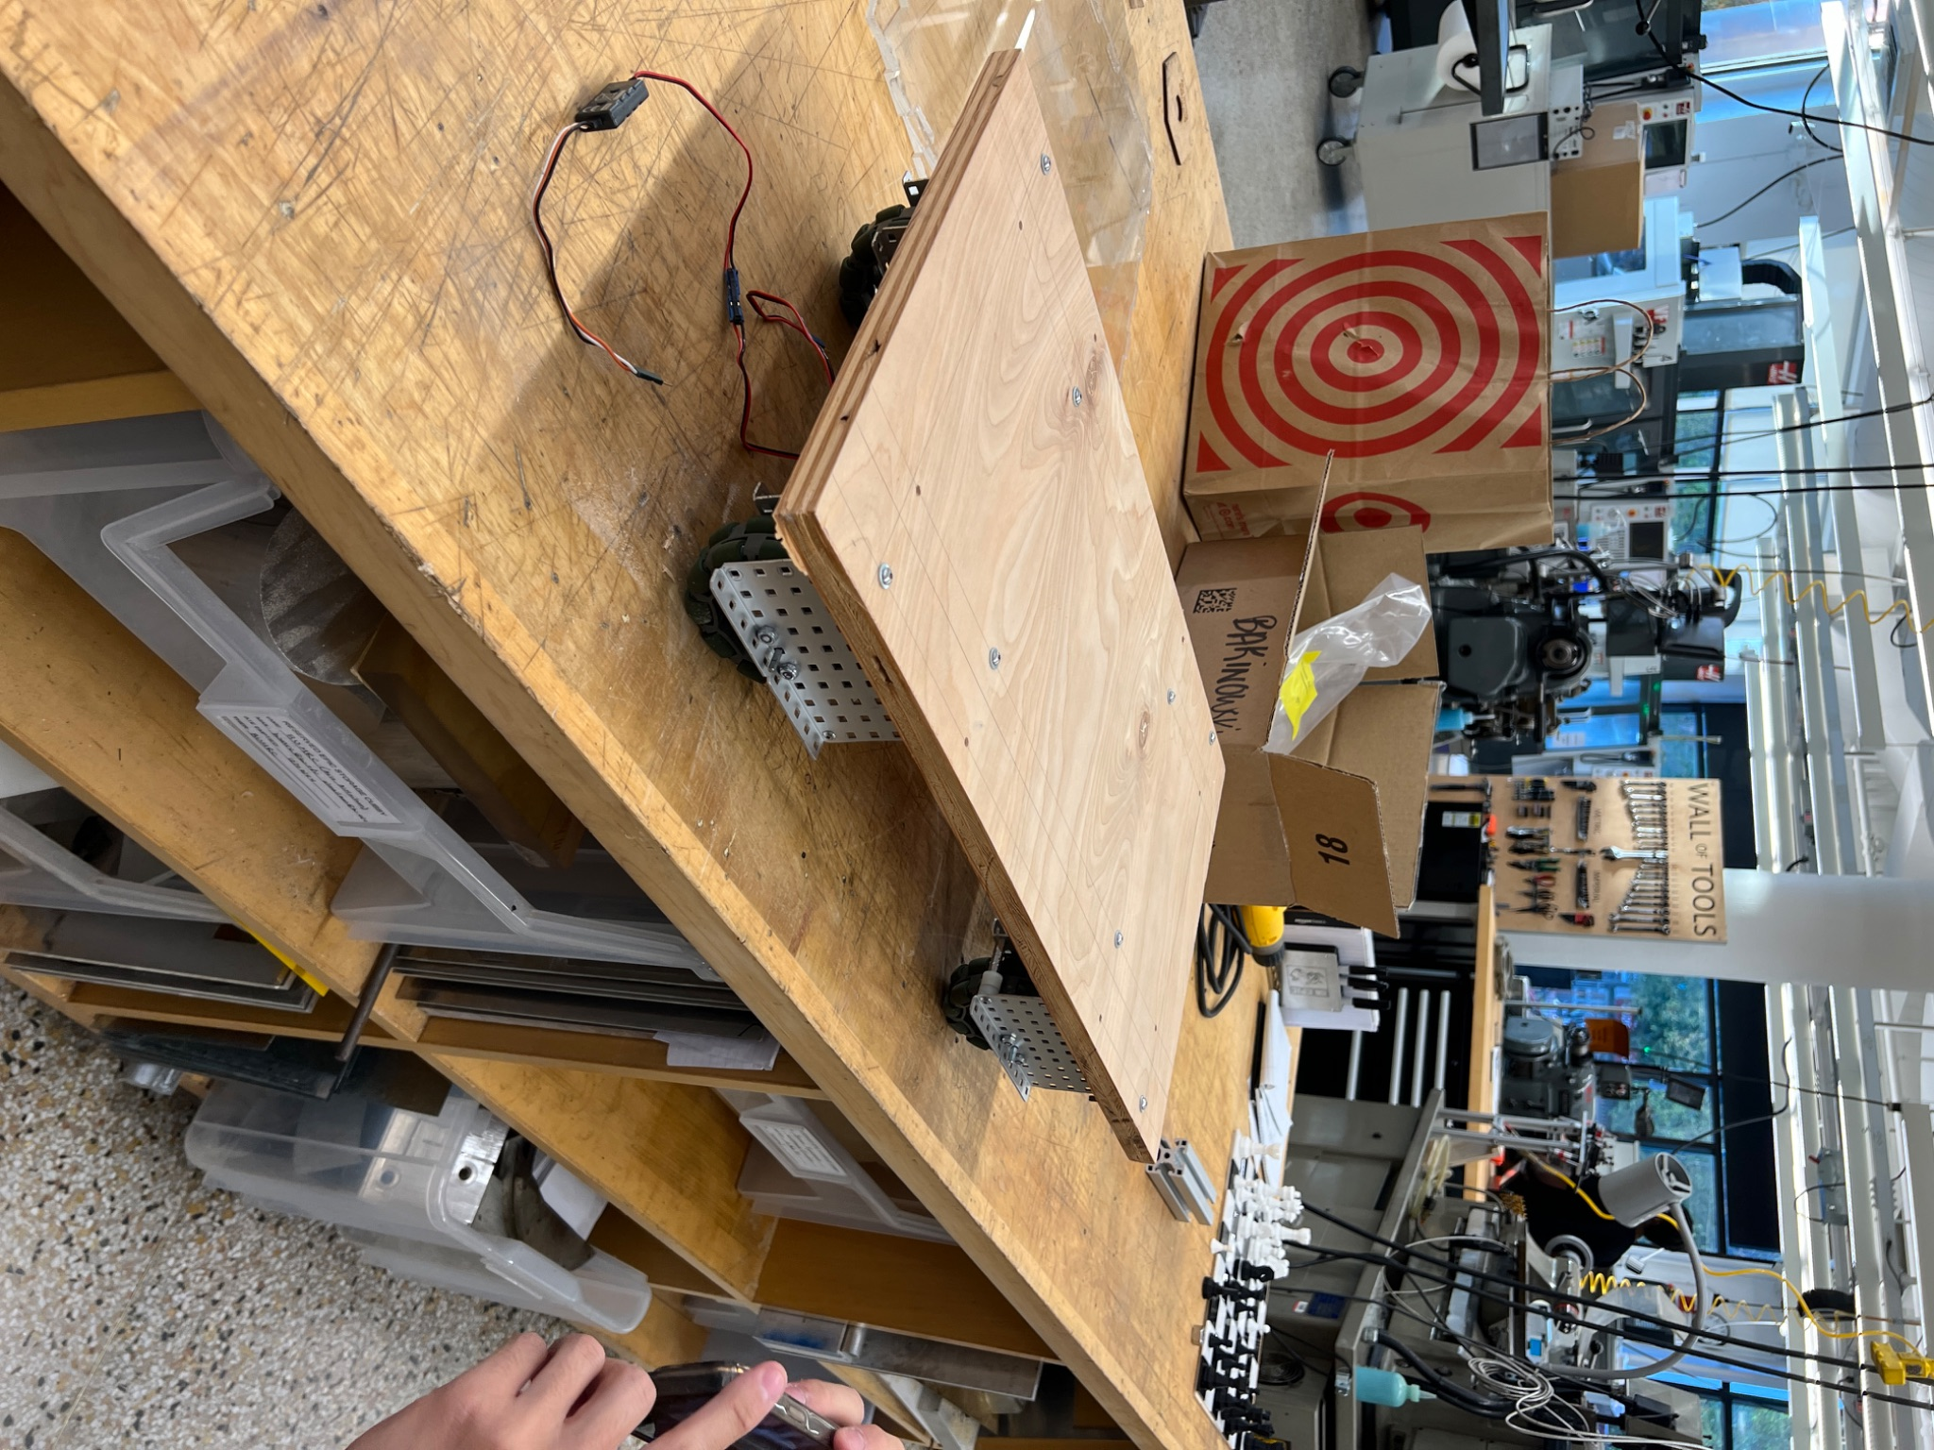
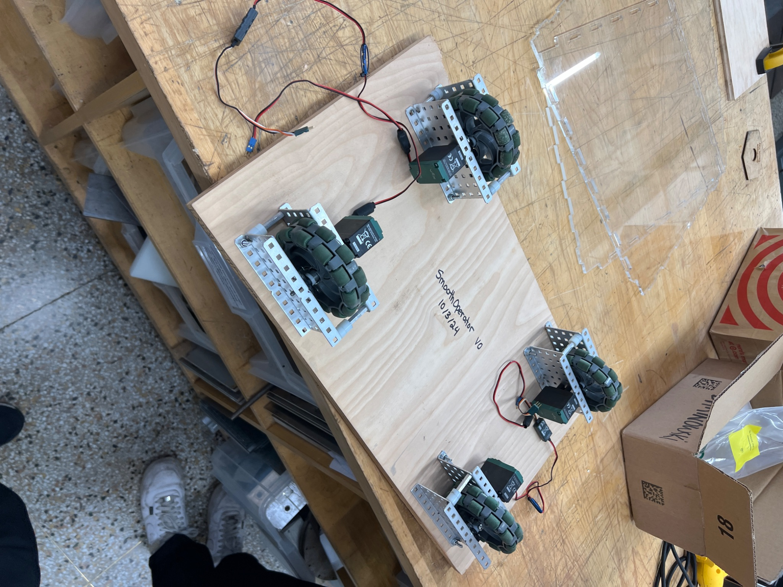
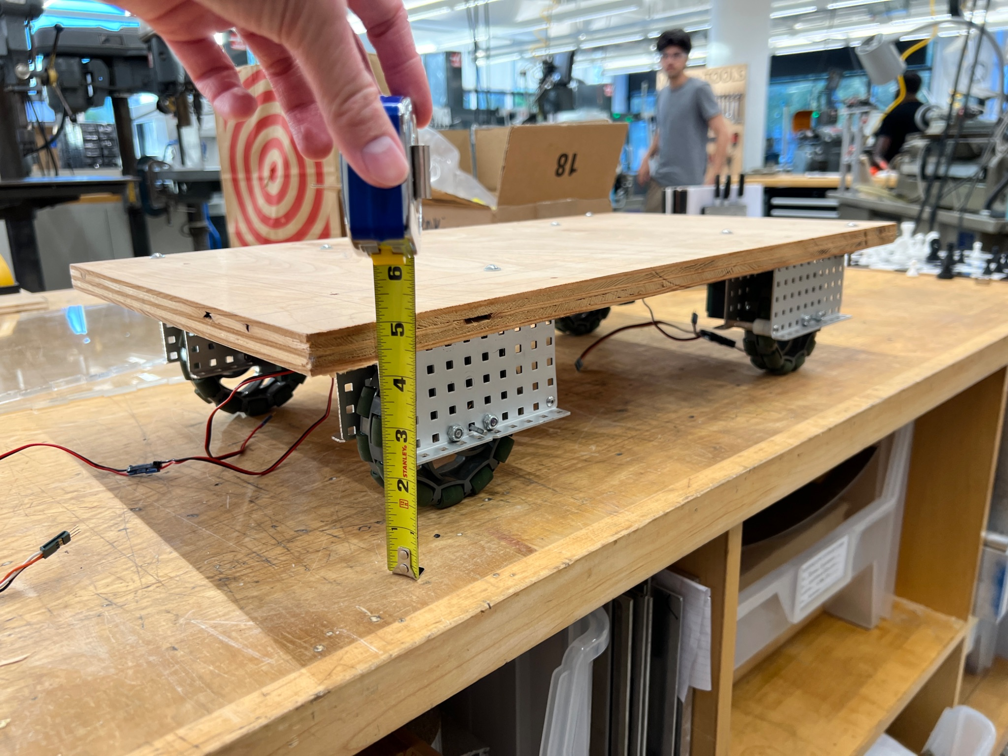
Chassis v0
Prototype Testing
Smooth Operator
Notes:
Celine

Slide 19
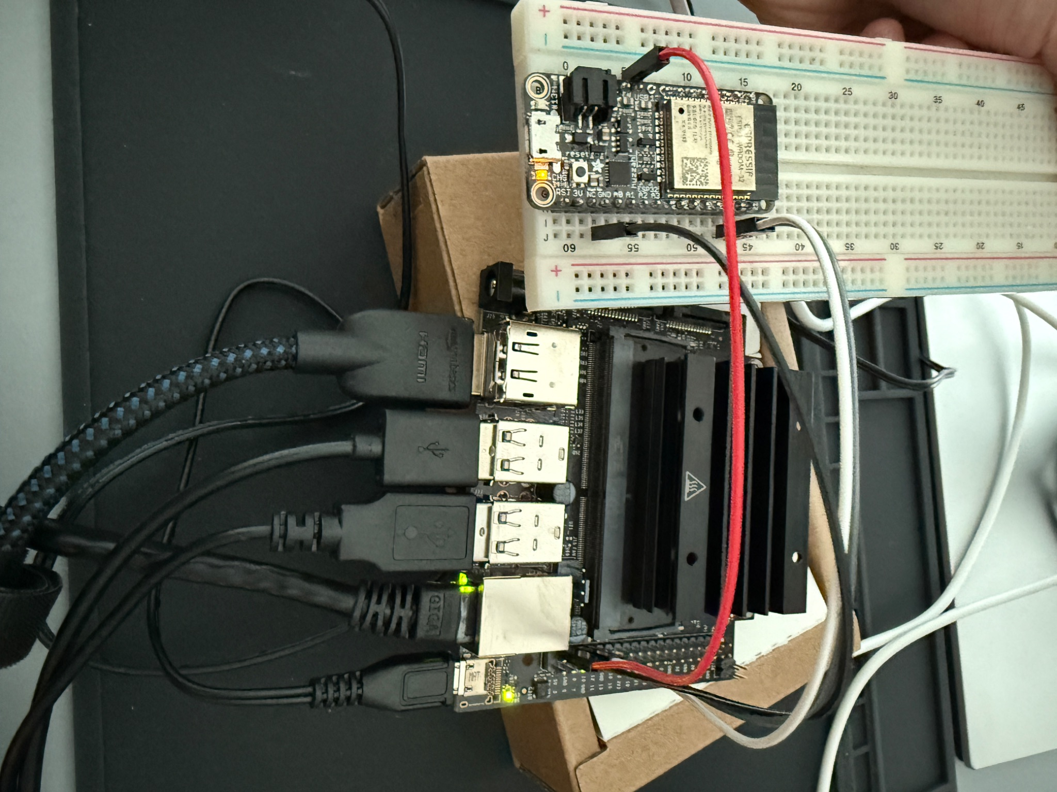
Jetson Nano to ESP-32 Communication
Prototype Testing
UART communication between the ESP32 and NVidia Jetson Nano
Smooth Operator
Notes:
Celine

Slide 20
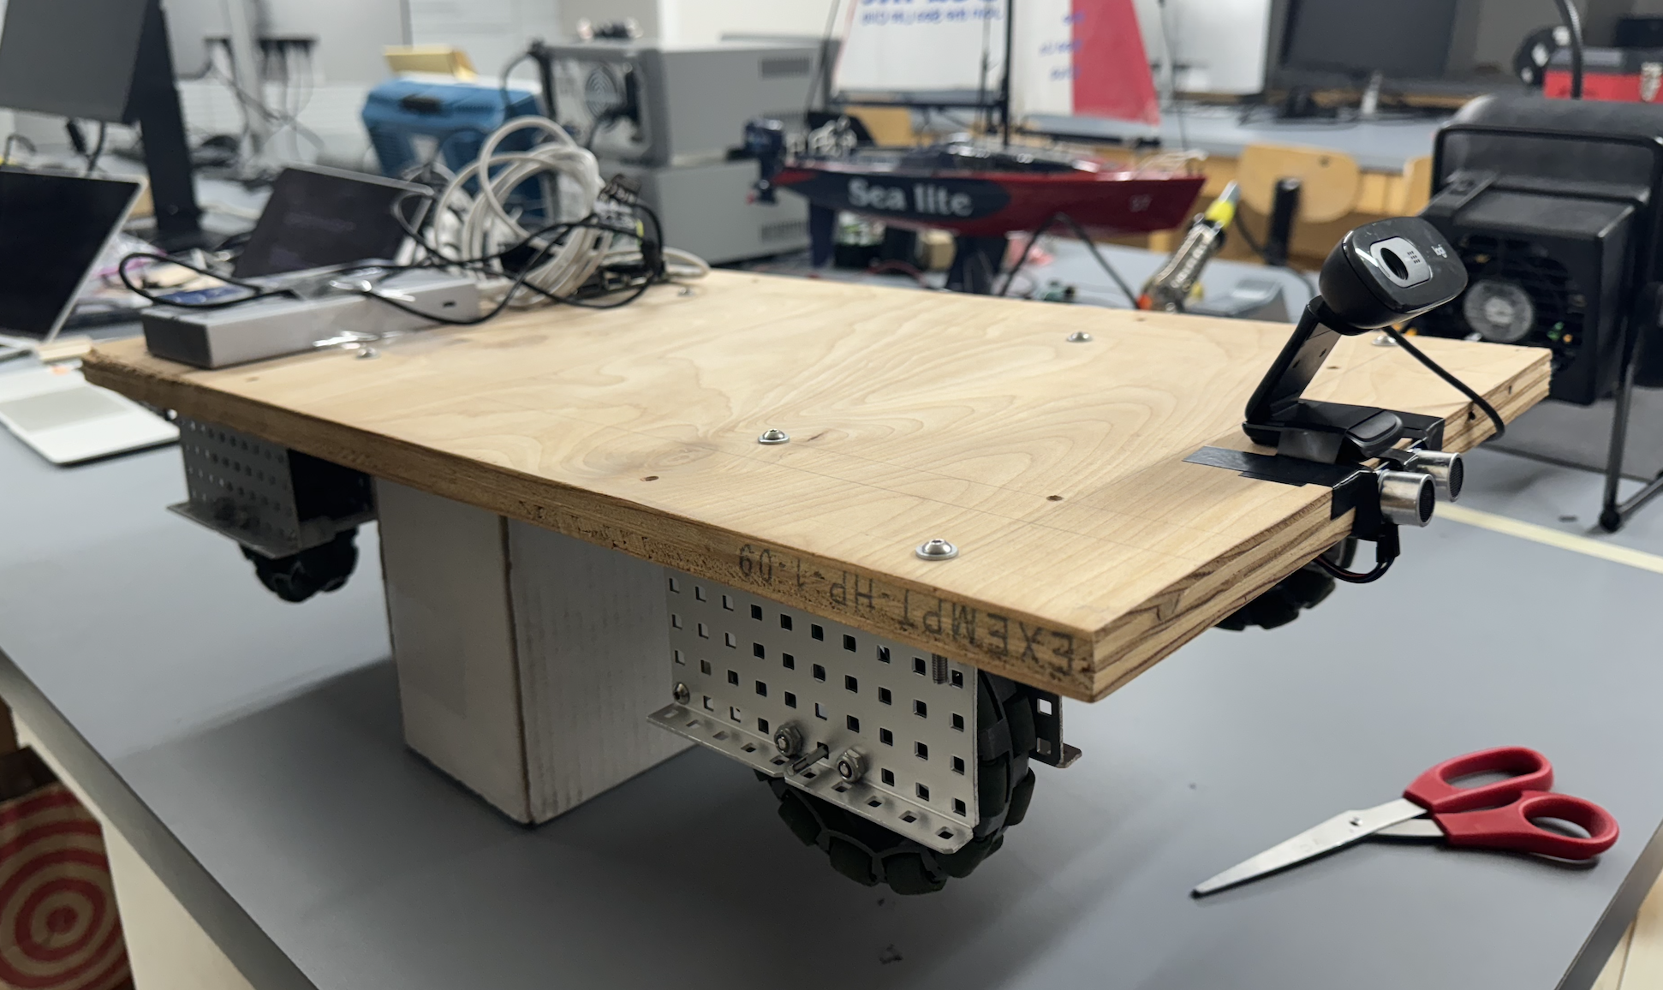
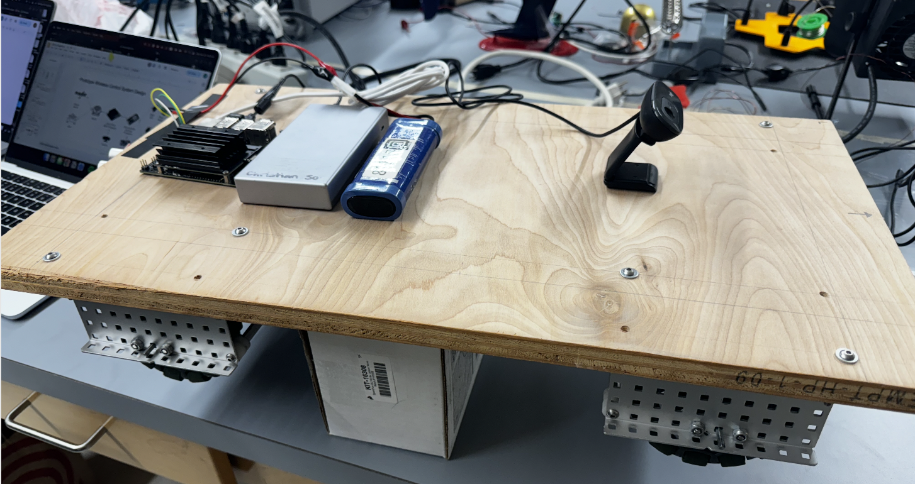
Wireless Prototype
Prototype Testing
Smooth Operator
Notes:
Celine

Slide 21
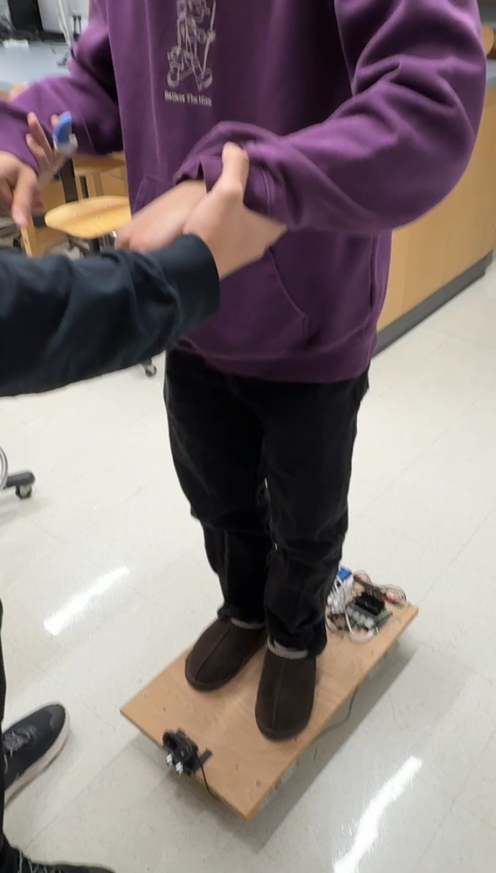
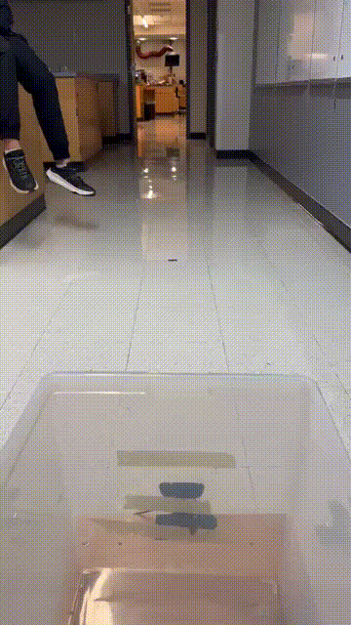
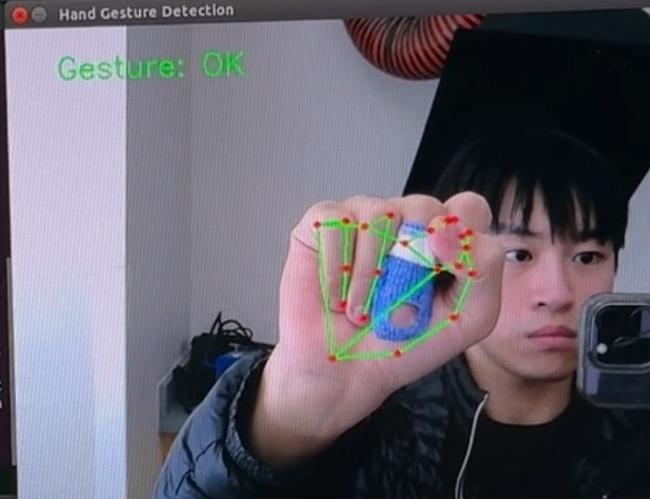
Test Results
Wireless communication between client and SmoothOperator
Secured through local subnet
SmoothOperator object detection was able to stop within 30 cm of obstacles (Hardware Interrupt)
Prototype was able to withstand ~130 lbs
Camera was able to detect fist gestures
Wireless Prototype Success
Material Strength Test
Hand Tracking with Jetson Nano allows the camera to detect fist gestures.
SmoothOperator
Notes:
Celine

Slide 22
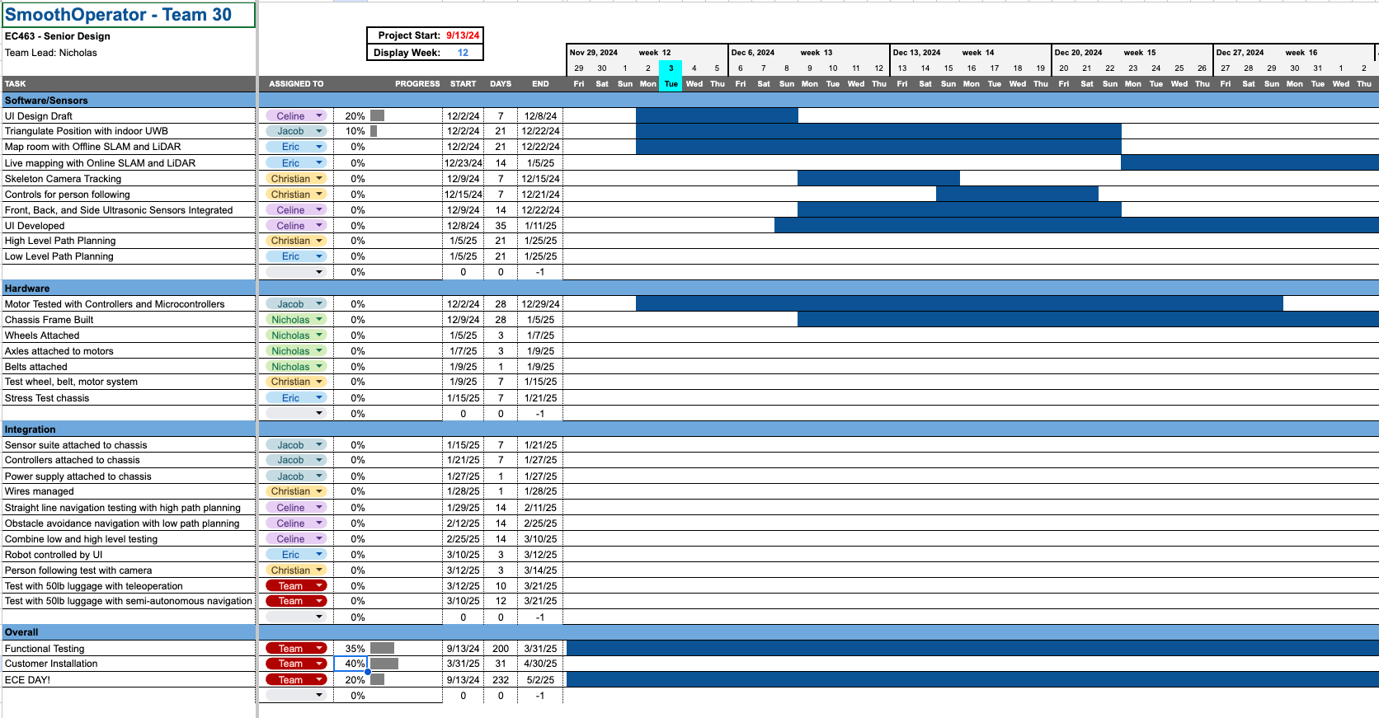
Gantt Chart
Project Management
Smooth Operator
Notes:
Christian

Slide 23
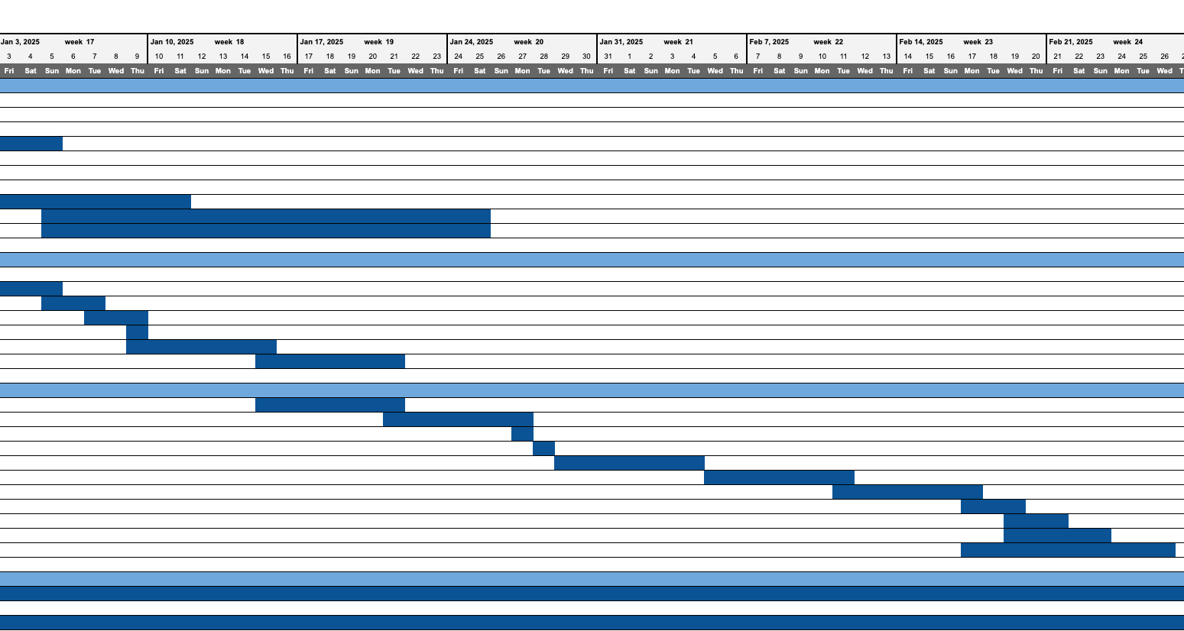
More on Google Sheets…
Smooth Operator
Notes:
Christian

Slide 24

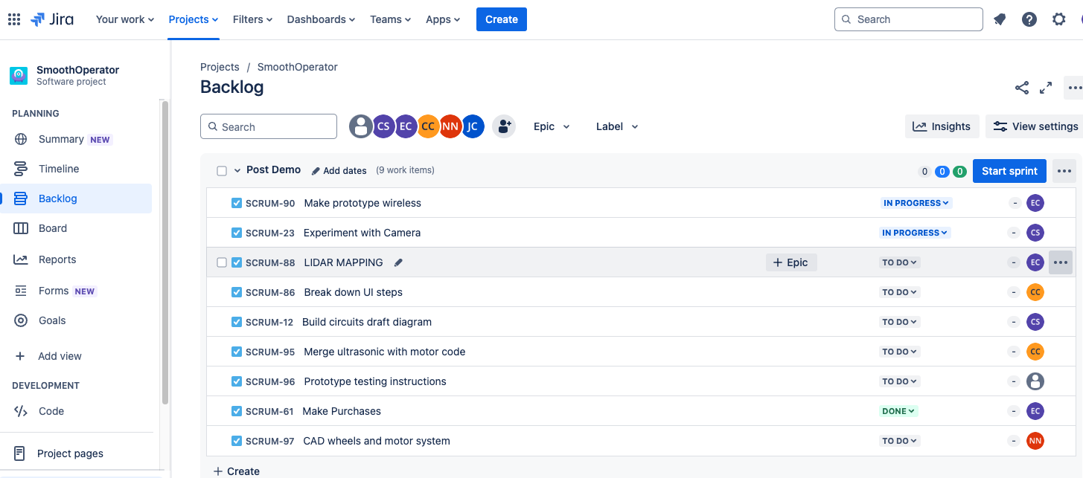
Jira Board & Sprints
Project Management
Smooth Operator
Notes:
Celine

Slide 25

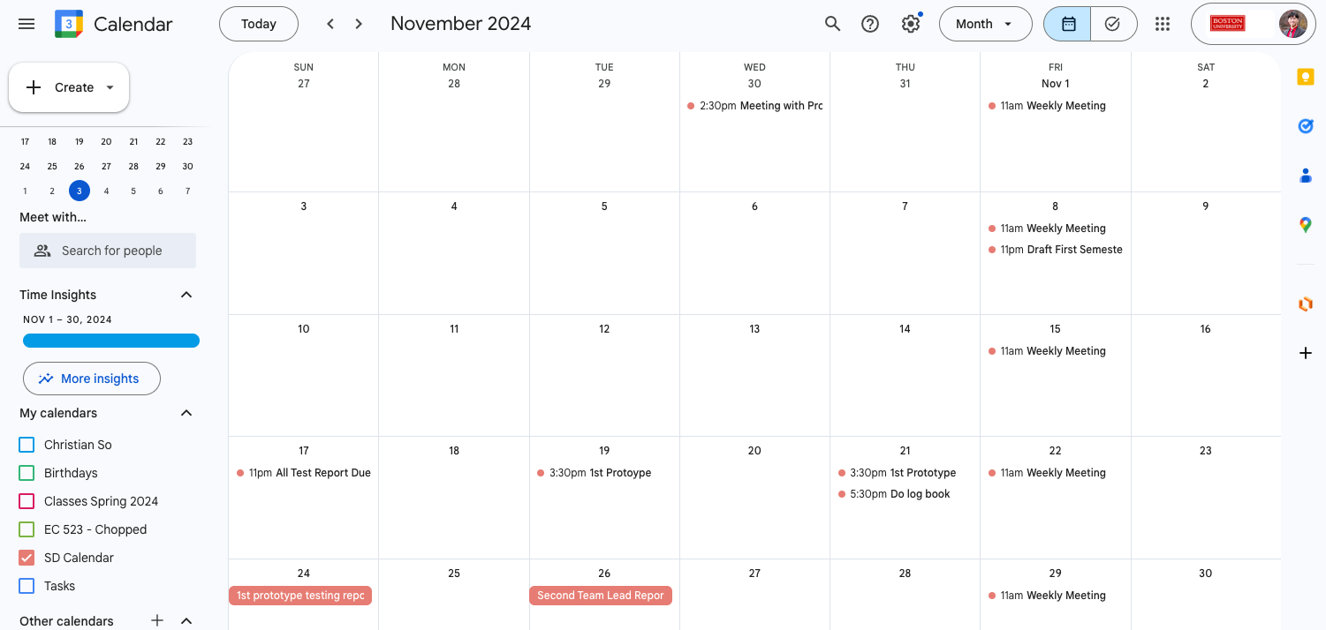
Google Calendar
Project Management
Smooth Operator
Notes:
Celine

Slide 26
Thank You
Questions/Comments?
SmoothOperator
Notes:
Celine

